Slide 1
Python
Daze lu
June 12, 2025

Slide 2
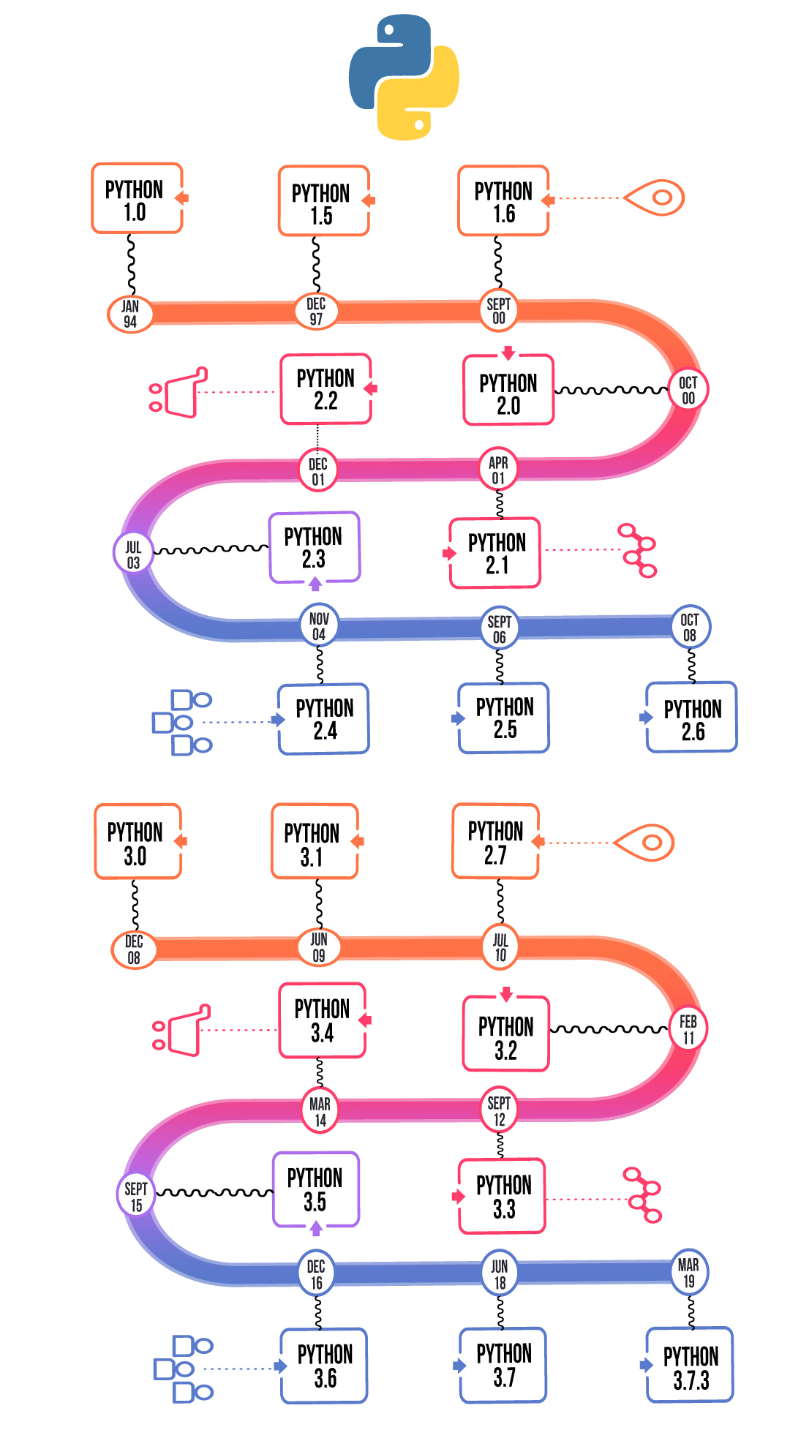
HISTORY
Python is a high-level programming language created by Guido van Rossum in 1989 and released in 1991. Developed at CWI in the Netherlands, it was inspired by the ABC language and named after the comedy show Monty Python’s Flying Circus. Python was designed to be simple and easy to read, with features like inheritance, exception handling, and built-in data types.
It has grown through major versions, with Python 3.12.1 being the latest as of 2025. Today, it’s widely used in web development, data science, automation, and more by companies like Google and Dropbox. Thanks to its clean syntax and strong community, Python is one of the most popular programming languages in the world.

Slide 3
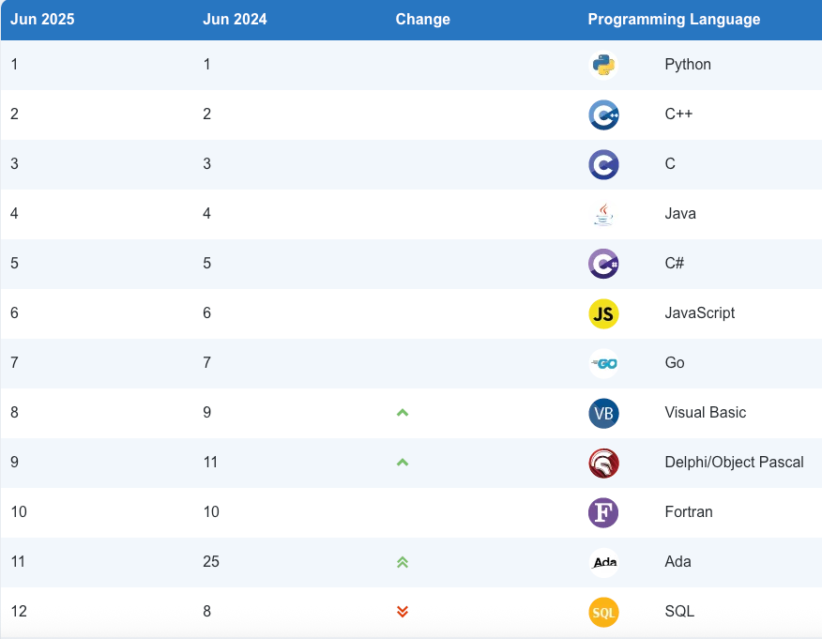
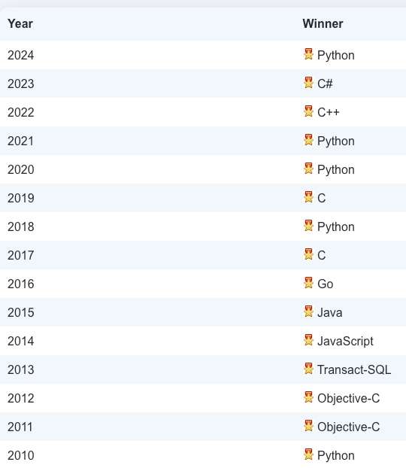
WHY PYTHON?

Slide 4
WHY PYTHON?
Easy to Learn & Readable
Clean, intuitive syntax—great for beginners.
Extensive Libraries & Frameworks
Powerful tools for data, AI, web, automation, and more.
Cross-Platform Support
Works on Windows, macOS, and Linux.
Fast for Development
Ideal for prototyping and building apps quickly.
Huge Community & Learning Resources
Plenty of tutorials, forums, and open-source support.
Excellent for Data Science & AI
Widely used in academia and industry for ML and analytics.
Flexible & Extensible
Integrates with C/C++ and other tools for performance.
Great for All Skill Levels & Fields
Suitable for beginners, analysts, engineers, and researchers.

Slide 5
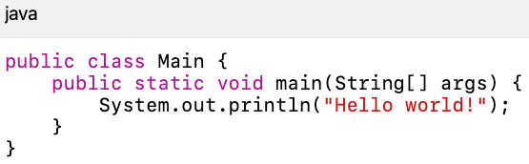

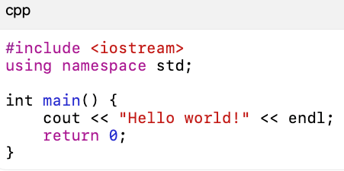
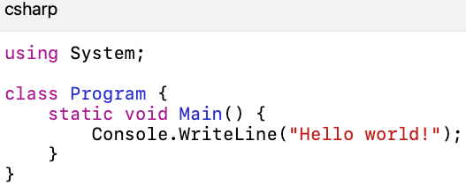
WHY PYTHON?

Slide 6
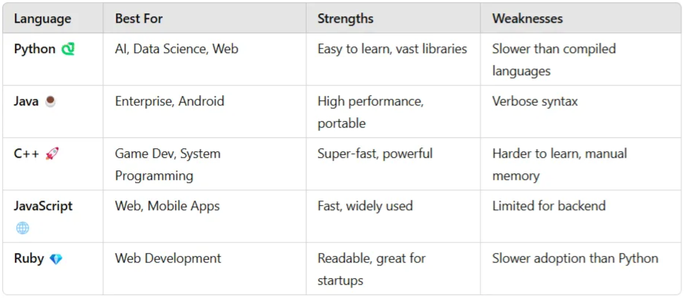
COMPARISON WITH OTHER LANGUAGES

Slide 7
ENVIRONMENT SET UP
HANDS ON PART
Anaconda or Miniconda

Slide 8
PYTHON KEYWORKDS
In Python, a keyword is a word that has a special meaning in the Python language. Keywords are used to define the syntax and structure of the Python language, and they cannot be used as identifiers (i.e., variable names, function names, etc.) in Python code.
and
as
assert
async
await
break
class
continue
def
del
elif
else
except
False
finally
for
from
global
if
import
in
is
lambda
None
nonlocal
not
or
pass
raise
return
True
try
while
with
yield

Slide 9
IDENTIFIERS
In Python, an identifier is a name used to identify a variable, function, class, module, or other objects. There are a few rules and conventions for naming identifiers in Python:
Identifiers must start with a letter or an underscore (_).
Identifiers cannot start with a number.
Identifiers can only contain letters, numbers, and underscores.
Identifiers are case-sensitive, so myVariable and myvariable are considered to be different identifiers.
Python reserves a set of keywords that cannot be used as identifiers. Examples include if, else, for, class, etc.
Identifiers should be descriptive and meaningful, using camelCase or snake_case, depending on the project’s style guide.

Slide 10
IDENTIFIERS
True
myVariable
calculate_average
class
1stVariable
_privateVariable
my-variable
MyClass
counter
if

Slide 11
VARIABLES
A Python variable is a reserved memory location to store values. In other words, a variable in a python program gives data to the computer for processing. Every value in Python has a datatype. Different data types in Python are Numbers, List, Tuple, Strings, Dictionary, etc. Variables can be declared by any name or even alphabets like a, aa, abc, etc.
n = 300 print(n)
Later, if you change the value of n and use it again, the new value will be substituted instead
n = 1000
Python also allows chained assignment, which makes it possible to assign the same value to several variables simultaneously:
a=b=c=300
x, y = 10, 20

Slide 12
VARIABLES
x, y = [10, 20]
point = 10, 20, 30 x, y, z = point (x, y, z) = (z, y, x)
x = [20, 20]
What are the values of x,y,z?
x, y = 'hi’

Slide 13
PYTHON STATEMENTS
In Python, a statement is a single line of code that performs a specific action or instruction. There are several types of statements in Python, including:
Expressions: These are statements that evaluate to a value, such as mathematical operations or function calls.
“2 + 2”
“print(‘Hello, world!’)”.
Assignment statements: These are statements that assign a value to a variable.
“x = 2”
“name = ‘John’”.
Control flow statements: These are statements that control the flow of execution of a program。
conditional statements (if/else)
loops (for/while).
Function and class definitions: These are statements that define a function or class, respectively.
“def my_function():”
“class MyClass:”.
Import statements: These statements are used to import modules or packages in python.
“import os”
“from math import sqrt”
Pass statements: A pass statement is a null operation. Nothing happens when it executes. It is useful as a placeholder when a statement is required syntactically, but no code needs to be executed

Slide 14
INDENTATION
Indentation is used in Python to indicate blocks of code. The standard indentation is four spaces, and most Python code follows this convention.
x = 5 if x > 0: print("x is positive") print("This line is not indented, so it's not part of the if block")

Slide 15
PYTHON DOCUMENTATION
In Python, documentation is typically included in the form of comments in the source code. These comments start with a # symbol, and everything following the # on that line is considered a comment.
Single Line Comment:
# This is a single line comment in Python x = 10 # This is also a single line comment
In Python, multi-line comments can be created using triple quotes, either single quotes (‘’’) or double quotes (“””). The comments can span multiple
""" This is a multiline comment. It can span multiple lines. """
''' This is a multiline comment. It can span multiple lines. '''

Slide 16
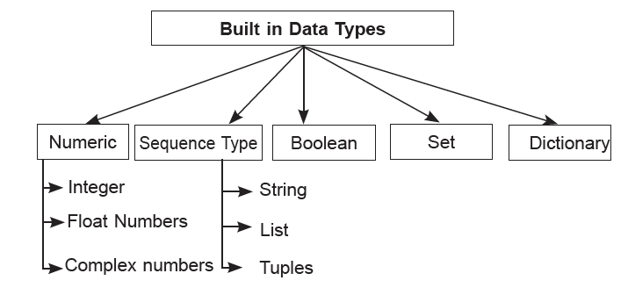
VARIABLE TYPES IN PYTHON
In many programming languages, variables are statically typed. That means a variable is initially declared to have a specific data type, and any value assigned to it during its lifetime must always have that type. Variables in Python are not subject to this restriction. In Python, a variable may be assigned a value of one type and then later re-assigned a value of a different type:

Slide 17
VARIABLE TYPES IN PYTHON
1. Integers
Whole numbers, positive or negative.
Examples: 42, -7, 0
2. Floating-point Numbers
Numbers with decimal points.
Examples: 3.14, -0.01
3. Complex Numbers
Numbers with real and imaginary parts.
Example: 3 + 6j
4. Strings
Sequences of characters, enclosed in quotes.
Examples: 'hello', "world", '42'
5. Booleans
Represent truth values.
Values: True, False
6. Lists
Ordered, mutable collections.
Defined with square brackets [].
Examples: [1, 2, 3], ['a', 'b'], [True, False]
7. Tuples
Ordered, immutable collections.
Defined with parentheses ().
Examples: (1, 2, 3), ('a', 'b', 'c'), (True, False)
8. Sets
Unordered, unique value collections.
Defined with curly braces {}.
Examples: {1, 2, 3}, {'a', 'b'}, {True, False}
9. Dictionaries
Unordered collections of key-value pairs.
Defined with curly braces {} and colons :.
Examples:
{'a': 1, 'b': 2}
{True: 'Yes', False: 'No'}

Slide 18
INTEGERS
Convert to integer
arithmetic operations
x = int("123") y = int(-456.7) z = int(7.9)
x = 2 + 3 y = 4 - 1 z = 2 * 3 w = 8 / 3
integer division
x = 8 // 3
find the remainder
x = 8 % 3

Slide 19
FLOATING-POINT NUMBERS
x = 3.14 # assign the value 3.14 to x y = 4.0 # assign the value 4.0 to y z = 0.01 # assign the value 0.01 to z # You can perform arithmetic with floating-point numbers just like with integers: a = x + y # a is now 7.14 b = y / z # b is now 400.0

Slide 20
COMPLEX NUMBERS
In Python, a complex number is a number that has both a real and an imaginary component. The real component is represented by a floating-point number, and the imaginary component is represented by the letter “j” or “J”. You can create a complex number by adding a real and an imaginary component together, using the “+”
x = 3 + 4j
You can also create a complex number using the built-in complex() function
x = complex(3, 4)
print(x.real) print(x.imag)
computation
x = 3 + 4j y = 2 + 3j print(x + y) print(x - y) print(x * y)

Slide 21
STRING
In Python, a string is a sequence of characters enclosed in quotation marks. You can use either single quotes or double quotes to create a string

